Slide 1
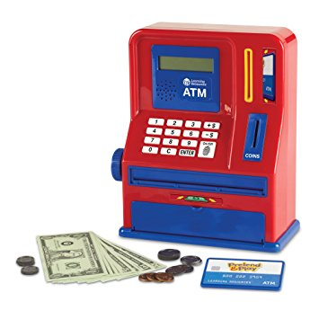
ATM Project
Mary Husain | Michal Porubcin | Andrew Quijano | Bryce Yoo
Notes:
Mary Husain
Michal Porubcin
Andrew Quijano
Bryce Yoo

Slide 2
Overview
Core Functionality
User Interface
Encryption
Database
Online ATM
User Accounts
Tools & Services
Paragraph (if not needed, delete)
Bullet
Dash
Subbullet
Paragraph (if not needed, delete)
Bullet
Dash
Subbullet
Paragraph (if not needed, delete)
Bullet
Dash
Subbullet

Slide 3
Core Functionality
User Accounts
First Name
Last Name
PIN Code
Account Balance
Services
Withdrawals
Multiples of $20
Quick withdrawal options from $20 - $100
Manual for amounts larger than $100
Deposits
Any positive amount (minimum $0.01)

Slide 4
User Interface

Slide 5
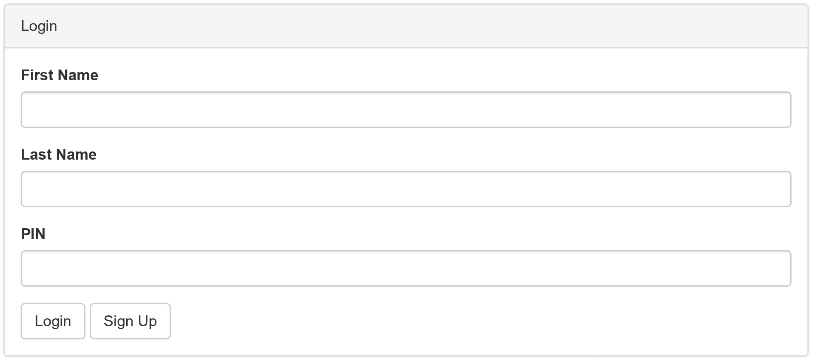
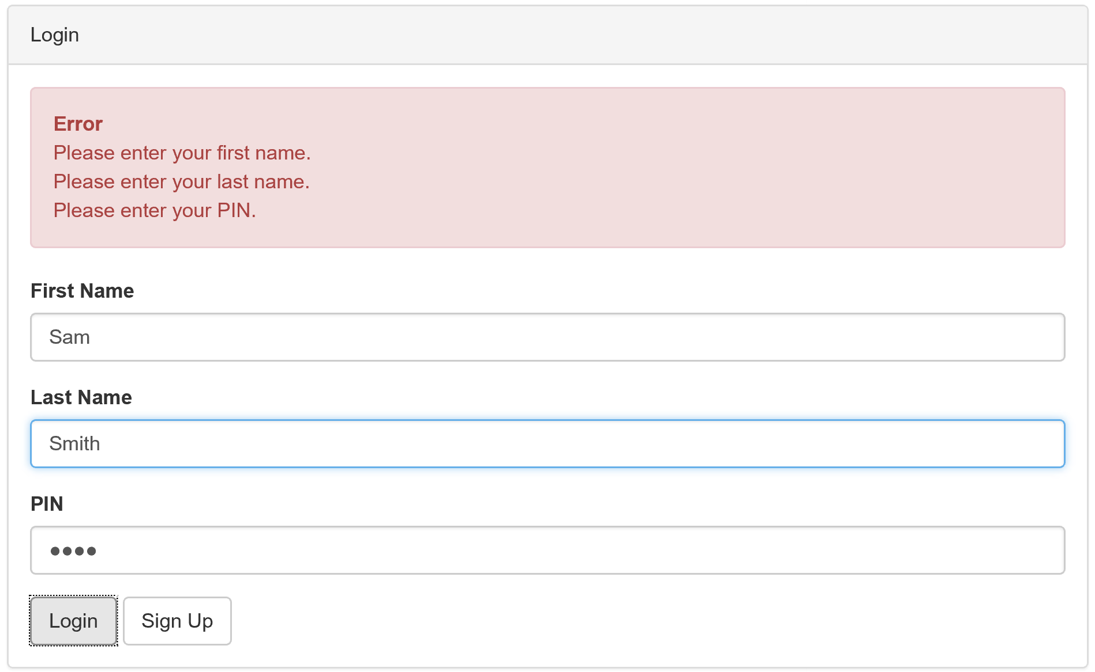
Login Screen and Validation

Slide 6
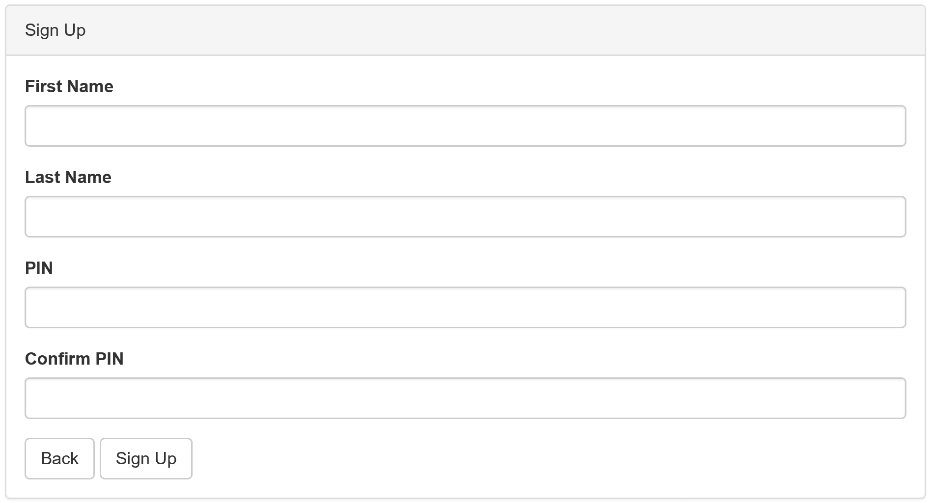
Sign Up Screen

Slide 7
Encryption and Security
Client
Client inserts PIN
Client hashes the PIN and sends the (what algorithm?) code to the ATM server
Server
The server has a copy of the Hash of the User’s PIN
The server compares the incoming hash from the client and the stored hash.

Slide 8
Database

Slide 9
Further Potential

